Slide 1


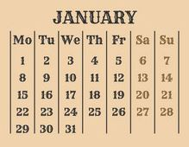
Restoration
Work
2024

Slide 2

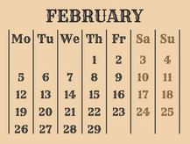
Restoration
Work
2024

Slide 3

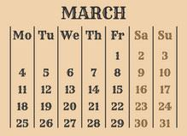
Restoration
Work
2024

Slide 4

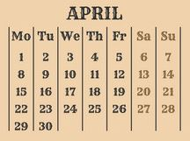
Restoration
Work
2024

Slide 5

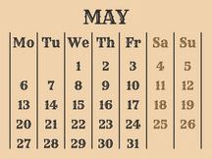
Restoration
Work
2024

Slide 6

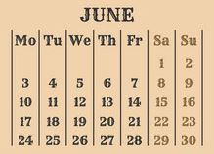
Restoration
Work
2024

Slide 7

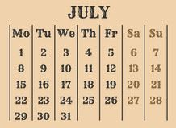
Restoration
Work
2024

Slide 8

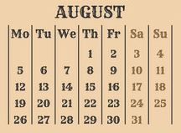
Restoration
Work
2024

Slide 9

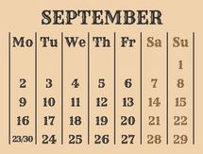
Restoration
Work
2024

Slide 10

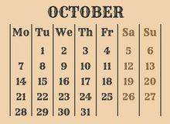
Restoration
Work
2024

Slide 11

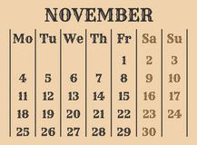
Restoration
Work
2024

Slide 12

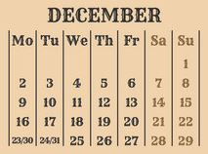
Restoration
Work
2024

